Slide 1
Handwritten Digit Recognition
AI/ML Internship Project – Edunet Foundation
PRESENTED BY:
Student Name – Panchal Manav Ketanbhai
Course Name –
College Name – Silver Oak University

Slide 2
OUTLINE
Introduction
Problem Statement
Proposed Solution
System Approach
Tools & Technologies
Streamlit Application Structure
System Architecture & Deployment
Results & Observations
Conclusion
Future Scope
References

Slide 3
Problem Statement
Students face significant challenges while planning trips due to limited budgets, lack of personalization, and scattered travel information across multiple platforms. Existing travel applications provide generic recommendations and do not strictly adhere to budget constraints. Additionally, students must manually calculate expenses, search locations, and plan routes separately. This leads to inefficient planning, wasted time, and poor budget management. Hence, there is a need for an intelligent system that can generate accurate, budget-aware, and personalized travel itineraries in a single platform.

Slide 4
Proposed Solution
Collect user inputs such as destination, travel dates, total budget, and personal interests through a web interface.
Validate and preprocess user inputs to ensure correct budget limits and trip duration.
Apply a zero-based budgeting approach to divide the total budget into categories like transport , food , and accommodation.
Use a Generative AI model (Llama-3 via Groq API) to generate a personalized, day-wise travel itinerary.
Ensure the AI strictly follows budget constraints while generating travel plans.
Convert place names into geographic coordinates using geocoding services.
Display the final itinerary along with interactive maps and budget breakdown charts.
Evaluate results based on budget accuracy, personalization quality, and user satisfaction.
Calculate optimal travel routes and distances using routing algorithms (OSRM).
Improve the system through prompt tuning, budget logic optimization, and feature enhancements

Slide 5
System Approach
The system accepts user input such as destination, budget, number of travel days, and interests through the Streamlit web interface.
User inputs are validated to ensure correct values for budget and trip duration.
The total budget is divided into categories using a zero-based budgeting algorithm.
User constraints and preferences are sent to the Generative AI model via the Groq API.
The AI model analyzes the inputs and generates a structured, day-wise travel itinerary.
Location names from the itinerary are extracted and converted into geographic coordinates using geocoding services.
Routing algorithms calculate optimal travel paths and distances between locations.
Interactive maps with routes and markers are generated using mapping libraries.
The final itinerary, maps, and budget breakdown are displayed to the user.
System performance is observed based on budget accuracy, response speed, and output relevance.

Slide 6
TOOLS & TECHNOLOGIES
Programming Language: Python
Frontend Framework: Streamlit
AI Model: Llama-3 (via Groq Cloud API)
Mapping Tools: Folium, Leaflet.js
Routing Engine: OSRM
Geocoding: Nominatim
Data Handling: Pandas, JSON
Version Control: Git & GitHub
Deployment: Streamlit Community Cloud / Local Hosting

Slide 7
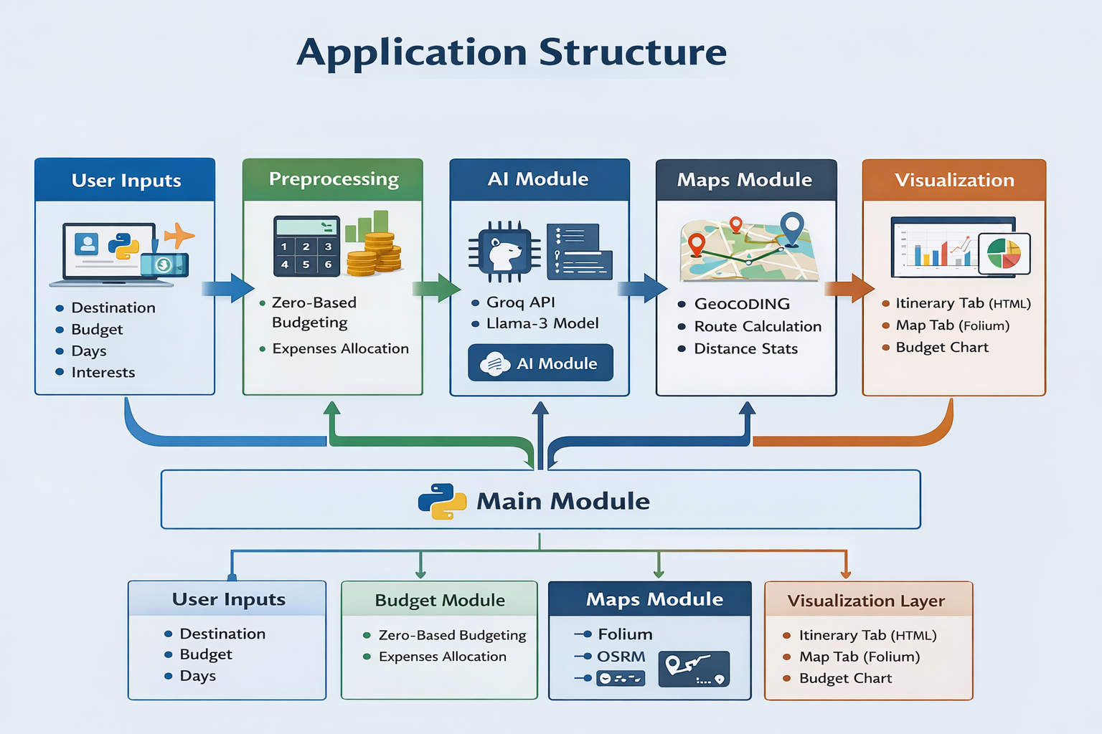
APPLICATION STRUCTURE

Slide 8
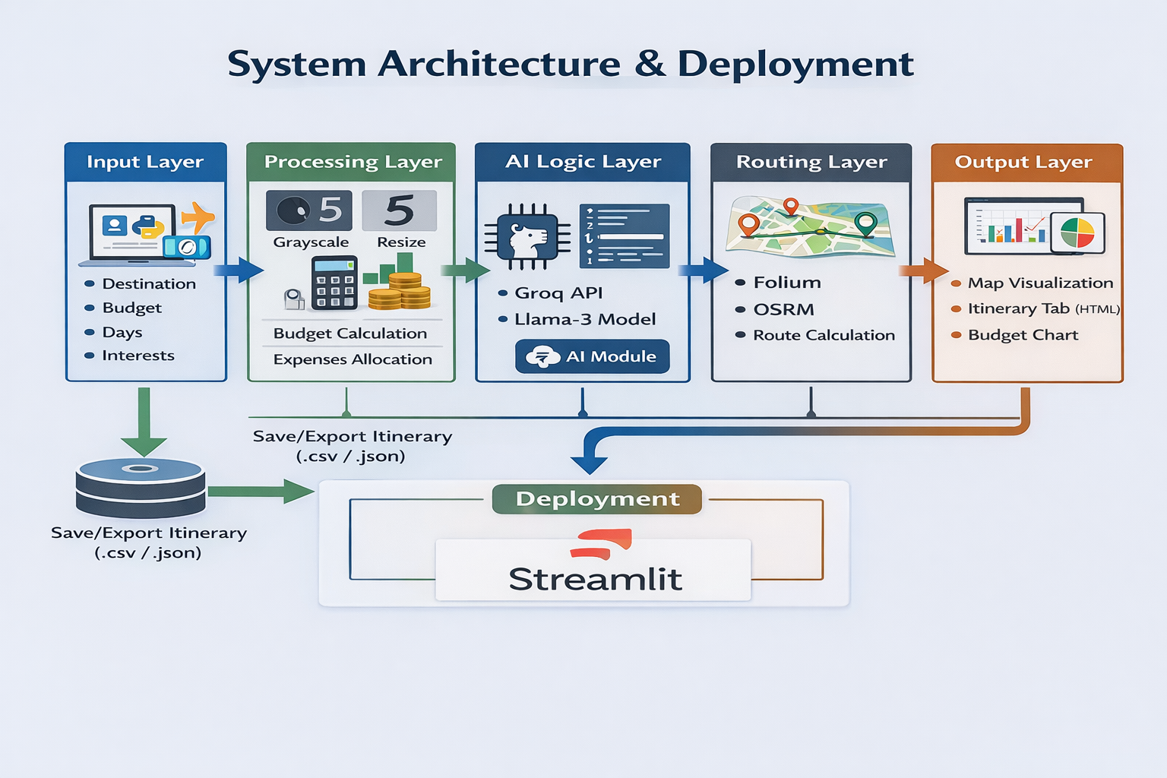
SYSTEM ARCHITECTURE & Deployment
.

Slide 9
Advantages
Automates complete travel planning
Strict budget adherence using zero-based budgeting
Personalized itineraries based on interests
Integrated AI and map visualization
Reduces manual effort and planning time
Student-friendly and easy-to-use interface
Scalable for future features

Slide 10
RESULTS
The AI-Powered Student Travel Planner successfully generates personalized travel itineraries based on user inputs.
The system produces day-wise travel plans within a few seconds.
Budget allocation strictly follows the user-defined total budget using zero-based budgeting.
Generated itineraries adapt dynamically to different interests such as adventure, food, or relaxation.
Interactive maps accurately display travel routes and location markers.
Route distances and travel paths are correctly calculated using routing services.
Budget breakdown charts clearly visualize expense distribution across categories.
The application performs reliably with fast response time and consistent outputs.
Overall results demonstrate effective integration of AI, budgeting logic, and geospatial visualization.

Slide 11
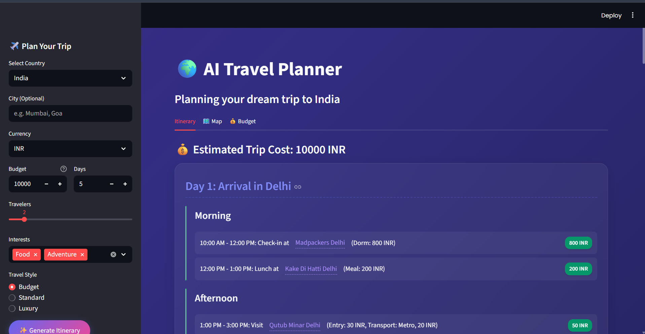

Slide 12
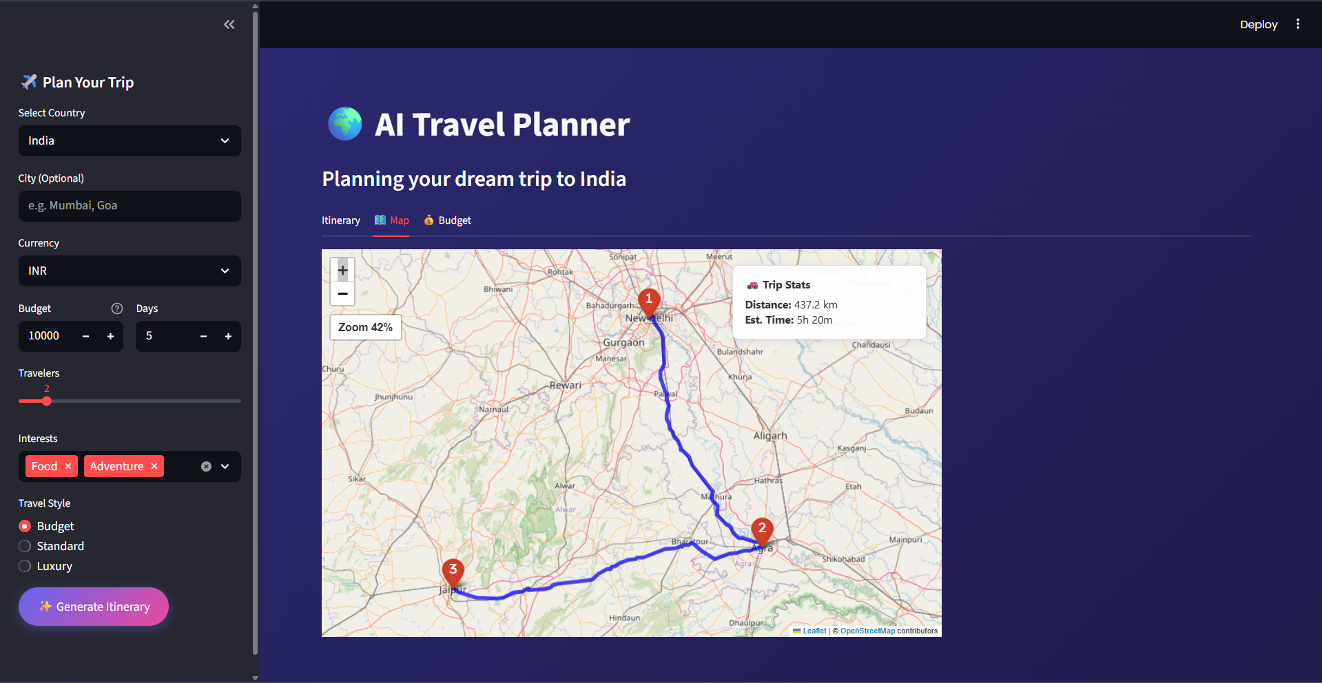

Slide 13
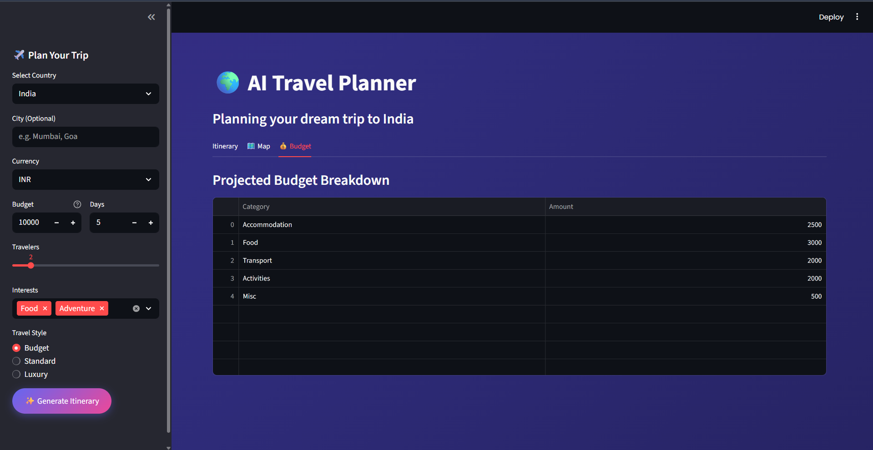

Slide 14
Conclusion
The AI-Powered Student Travel Planner effectively demonstrates how Generative AI and geospatial technologies can simplify complex travel planning tasks. The system provides accurate, personalized, and budget-aware itineraries, making travel planning accessible and stress-free for students. This project highlights the practical application of AI in solving real-world problems.

Slide 15
FUture scope
Real-time price integration for hotels and transport
Support for public transport and walking routes
User login and saved itineraries
PDF and shareable itinerary exports
Mobile application version
AI learning from past trips

Slide 16
references
Groq Cloud Documentation
Meta Llama-3 Model Documentation
Streamlit Official Documentation
OpenStreetMap & OSRM Documentation
Research papers on AI-based travel recommendation systems

Slide 17
Github link
Steamlit link
https://ai-student-travel-planner.streamlit.app/

